Slide 1

DriverPass System Analysis
Maria Stefania Hagedorn
Notes:
[No speaker notes required for this slide.]

Slide 2

System Requirements
Functional Requirements:
Allow student to register for training session.
allow the users to access all the schedules of the training and exams.
Nonfunctional Requirements:
Ensure simultaneous training requests are responsive.
Secure user and payment data.
Notes:
DriverPass's functional requirements focus on user registration and on the road training booking. These features help the platform achieve its goal of seamless on the road training-sharing connections.
The DriverPass community begins with user registration. This criterion allows student to easily create accounts, ensuring inclusion and accessibility. This functionality enables involvement and engagement whether a person wants to ride or check exam status. DriverPass's user base grows as individuals register, creating a vibrant training-sharing network.
On the road training session booking, the second function, is essential. This function lets consumers request on the road training session and owner accept them, making on the road training-sharing efficient. The on the road training booking functionality simplifies the process, giving student safe and convenient training session and DMV a chance to make money and support sustainable classes.
Nonfunctional criteria address key features of a successful and user-friendly platform in addition to functional requirements. Performance is prioritized to provide a responsive system that can efficiently handle concurrent ride requests. This minimizes delays and disturbances, improving user happiness and boosting platform use.
Security is crucial to protect sensitive user data and payment details. DriverPass builds user trust by securely storing and delivering this information. Users can use the platform safely knowing their personal data is protected. This solution protects privacy and ride-sharing network integrity.

Slide 3
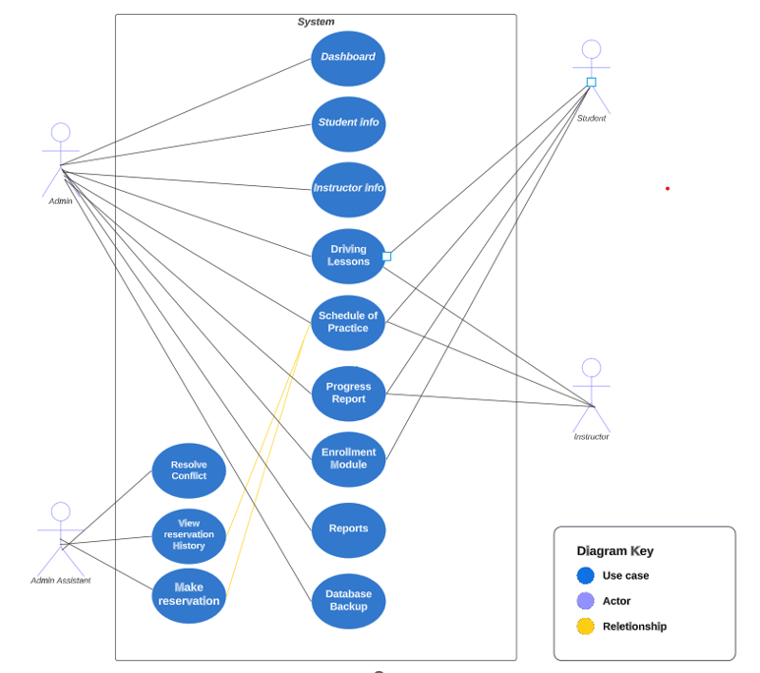
Use Case Diagram
Notes:
The use case diagram depicts the dynamic interactions between users and DriverPass, highlighting its essential functions. In this graphic, users interact with the platform seamlessly, aligning with DriverPass's goal of simplifying on the road training-sharing for student and trainers.
A detailed diagram shows where users and the system interact. Its core feature is user registration. DriverPass's easy account creation for student shows its universality. DriverPass touts itself as a platform that meets the demands of student and DMV by allowing this procedure.
Beyond user registration, the figure gracefully depicts training booking. To request training, users interact with the system naturally. The system shows users available classes to help with this. DriverPass makes it easy for users to book training with a few clicks. DMV can accept training requests, demonstrating the platform's collaborative character.
Central to the design is security. The diagram implies DriverPass's commitment to data and payment security. Users trust the platform because sensitive data is safely kept and sent. DriverPass prioritizes security to provide a safe and reliable environment for all users.

Slide 4
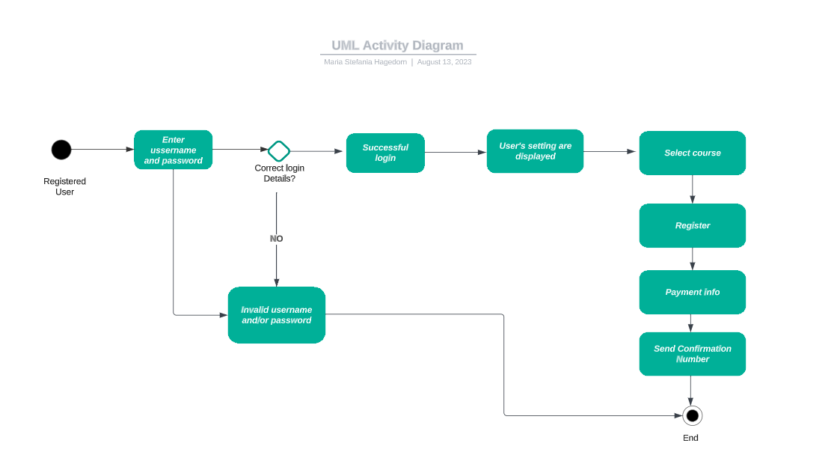
Activity Diagram
Notes:
A well-defined series of processes makes DriverPass training on the road requests easy and efficient. This concise analysis describes the user experience from initial action to final confirmation.
The adventure begins when the user selects “Select Course". This purposeful choice starts the cycle of events. The system then quickly displays a wide range of classes, giving the user many alternatives. This phase is vital since it allows the user to make an informed decision based on location, Trainer and class.
User interaction continues when they browse the list and choose a class. This choice gives users agency and improves the user experience. After selecting a driver, the system effortlessly transfers the user's ride request to the driver. Instantaneous communication streamlines interaction and ensures clear intent.
The Instructor takes over and quickly evaluates the request. The user-centric design gives instructors all the information they need to decide. Bilateral communication between student and instructor promotes understanding and collaboration.
The instructor accepting the ride request is the culmination of this process. This affirmative action confirms the user's purpose and strengthens the relationship.
The system confirms the ride, highlighting the user's first action's success. This final step gives users confidence that their request has been received, processed, and validated.

Slide 5
Security
User authentication: Logging in with valid credentials secures accounts.
Data Encryption: User and payment data are encrypted during transmission and storage.
Access Control: Only users can access their own data.
Notes:
DriverPass, like any digital platform, needs security. The system uses authentication, data encryption, and access restriction to provide security.
User authentication is the first layer of defense, needing valid credentials before accessing the system. This prevents unwanted access to sensitive user data and functions by restricting logins to authorized users. DriverPass verifies user identities with strong authentication procedures, building confidence and security.
Data encryption is crucial for user and transactional data security. Data exchanged between users and the system or stored on the platform is encrypted using modern algorithms. This encryption makes data unreadable to unauthorized parties, decreasing data breaches and interceptions. DriverPass protects user data from security breaches by prioritizing data encryption.
Access control strengthens security by restricting users to authorized resources and functions. This protects important functions and data from unauthorized users. Instructors should only have related features, while students should only have basic options. DriverPass carefully defines access permissions to monitor and restrict user activities, reducing the danger of unwanted acts.
DriverPass needs a secure platform, thus these security measures fit. Authentication, data encryption, and access control boost user confidence and follow industry best practices for data and transaction security. DriverPass prioritizes security to create a safe and trustworthy environment for instructors and students, improving the user experience and encouraging platform engagement.

Slide 6
System Limitations
Limited Coverage: The system may have limited availability in certain geographical areas.
Internet Connection: Users require a stable internet connection to use the app effectively.
Notes:
These limits are a practical realization of the system's geographical reach and internet connectivity constraints. Addressing these limits publicly helps manage user expectations and improve transparency.
First, the system's coverage may not be available in all regions. This may limit or prevent system services in some areas. Thus, consumers in places with limited system coverage may struggle to fully benefit from its offerings. Recognizing this constraint beforehand lets potential users determine if their location is covered by the technology, saving disappointment or frustration.
The second limitation, internet connectivity reliance, emphasizes the need for a stable and constant internet connection to maximize system use. The system's functionality may be difficult to use in places with poor internet connectivity. This could cause service outages, ride booking delays, and other issues. By showing this dependency, the technology helps users analyze their internet connectivity and make informed platform participation decisions.
Being upfront about these limits helps users interact with the system more honestly and informedly. Users will grasp the system's limits and adapt their expectations. This proactive approach to addressing possible issues improves user happiness and system confidence. By providing clear insights into these restrictions, the system shows a dedication to user-centric design and service, improving the overall experience despite constraints.

